Slide 1
COMP-7150 Natural Language Processing Instructor: Salim Sazzed Department of Computer Science University of Memphis

Slide 2
History of NLP
1950s-1960s: Early Foundations
The field of NLP began in the late 1950s and early 1960s with the advent of computers and the development of linguistic theories.
Pioneering work by scholars like Noam Chomsky in formal language theory influenced early NLP research.

Slide 3
Rule-Based Systems (1)
Rule-based systems dominated NLP during the 1970s. Researchers attempted to encode grammatical rules and linguistic structures into computer programs.
Projects like SHRDLU (1970), a natural language understanding system, showcased early attempts at dialogue-based interaction.
The project aimed to explore the possibilities of natural language understanding and interaction with a computer.

Slide 4
Rule-Based Systems (2)
Example: ELIZA (1966)
Description: ELIZA was an early rule-based NLP system designed to simulate conversation.
Developed by Joseph Weizenbaum, ELIZA used simple pattern-matching rules to respond to user inputs

Slide 5
1980s-1990s: Statistical Approaches
The 1980s saw a shift towards statistical approaches to NLP, fueled by the availability of large text corpora and computational power.
The introduction of machine learning techniques, such as Hidden Markov Models (HMM) and probabilistic context-free grammars, gained prominence.
The development of part-of-speech tagging and speech recognition systems using statistical methods marked significant progress.

Slide 6
Example: Hidden Markov Models (HMM) for Part-of-Speech Tagging
Description: In the 1990s, statistical models like Hidden Markov Models gained popularity.
HMMs were used for tasks such as part-of-speech tagging, where the probability of a sequence of words given a particular part-of-speech sequence was modeled statistically.

Slide 7
Rise of Machine Learning and Evaluation Metrics
The 2000s witnessed the rise of machine learning techniques, particularly with the advent of Support Vector Machines (SVM) and Maximum Entropy models.
Evaluation metrics, such as BLEU for machine translation and F1 score for information retrieval, became standard measures of NLP system performance.

Slide 8
Example: Support Vector Machines (SVM) for Text Classification
Description: In the 2000s, machine learning techniques like Support Vector Machines were applied to NLP tasks. SVMs, for instance, were used for text classification, where documents could be categorized into different classes based on their content.

Slide 9
2010s: Deep Learning Revolution
The 2010s brought about a paradigm shift in NLP with the rise of deep learning and neural networks.
The introduction of word embeddings (e.g., Word2Vec, GloVe) allowed words to be represented as dense vectors, capturing semantic relationships.
Transformer models, such as BERT (Bidirectional Encoder Representations from Transformers) and GPT (Generative Pre-trained Transformer), achieved state-of-the-art results across various NLP tasks.
Transfer learning became a dominant approach, where models pre-trained on large datasets demonstrated improved performance on downstream tasks.

Slide 10
Example: BERT (Bidirectional Encoder Representations from Transformers) (2018)
Description: BERT is a pre-trained transformer-based language model that achieved remarkable success in a wide range of NLP tasks, such as question answering, sentiment analysis, and named entity recognition. BERT's bidirectional context understanding and attention mechanisms significantly improved the ability to capture contextual information in language.

Slide 11
2020s: Continued Innovation and Ethical Considerations
In the 2020s, research in NLP continues with a focus on refining pre-trained models, addressing bias and ethical concerns, and developing models for low-resource languages.
Advancements in few-shot learning, multitask learning, and interpretability are actively explored.

Slide 12
Example: Gender Bias in Resume Screening
Scenario: Imagine a company develops a machine learning model to screen job applications and identify potential candidates for interviews.
Bias in Training Data: The training data used to train the model reflects the historical bias in hiring. For example, if the historical data shows a tendency to select more male candidates than female candidates for certain roles, the model may learn this bias.
Impact: When the biased model is deployed to screen new resumes, it may unfairly disadvantage female candidates.
The model might associate certain words, experiences, or qualifications more strongly with male candidates, leading to a systematic disadvantage for female applicants.

Slide 13
Some Challenges

Slide 14
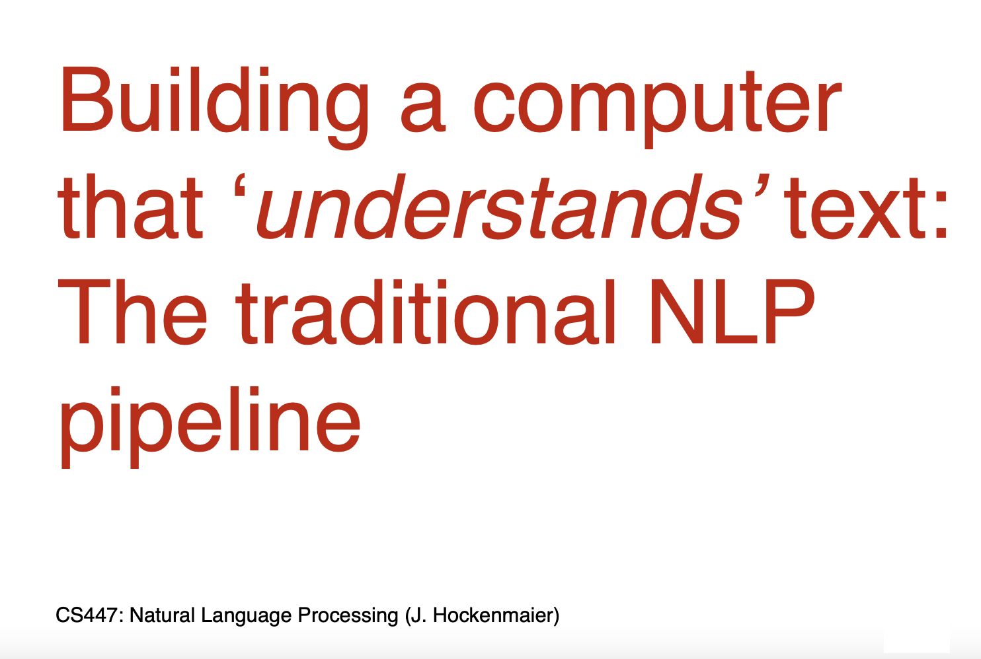
What could be some challenges?

Slide 15
Task: Text tokenization
Tokenization: Process of converting a sequence of text into smaller parts, known as tokens.
Needed for Search engines, Machine translation, etc.
Let's consider the sentence, "Chatbots are helpful”
Simple and obvious way is to use Space character-
["Chatbots", "are", "helpful"].

Slide 16
Wait! , not so simple…..
What about the following sentence-
“There was an earthquake near D.C. You could even feel it in Philadelphia, New York, etc. “
What we will get-
[There’, ‘was’, ‘an’, ‘earthquake’, ‘near’, ‘D.C.’, You’, ‘could’, ‘even’, ‘feel’, ‘it’, ‘in’ ‘Philadelphia,’ , ‘New’, ‘York,’ , ‘etc.’ ]
What we want-
[There’, ‘was’, ‘an’, ‘earthquake’, ‘near’, ‘D.C.’, You could even feel it in ‘Philadelphia’ , ‘New York’ , ‘etc’ ]

Slide 17
Ambiguity
Ambiguity: Language is inherently ambiguous. Consider the sentence "Flying planes can be dangerous."
Depending on how it's tokenized and interpreted, it could mean that the act of piloting planes is risky or that planes in flight pose a danger. Such ambiguities can lead to vastly different interpretations.
https://www.datacamp.com/blog/what-is-tokenization#:~:text=Here%27s%20a%20deeper%20dive%20into%20some%20of%20these,Texts%20often%20contain%20more%20than%20just%20words.%20

Slide 18
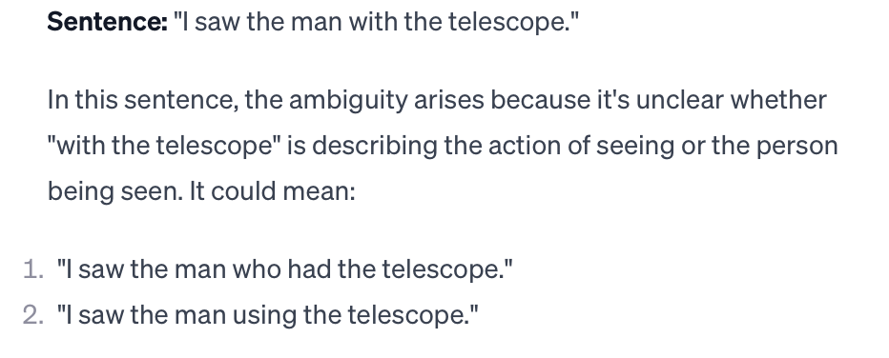
Structural Ambiguity:

Slide 19
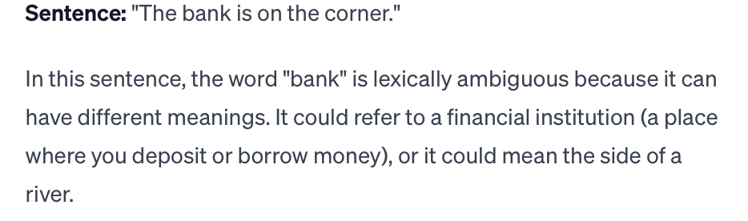
Lexical Ambiguity:
Lexical ambiguity occurs when a word or phrase has multiple meanings, and it's unclear which specific meaning is intended in a particular context.
Unlike structural ambiguity, which is related to the sentence structure and how words are arranged, lexical ambiguity is associated with the inherent multiple meanings of individual words or expressions.

Slide 20
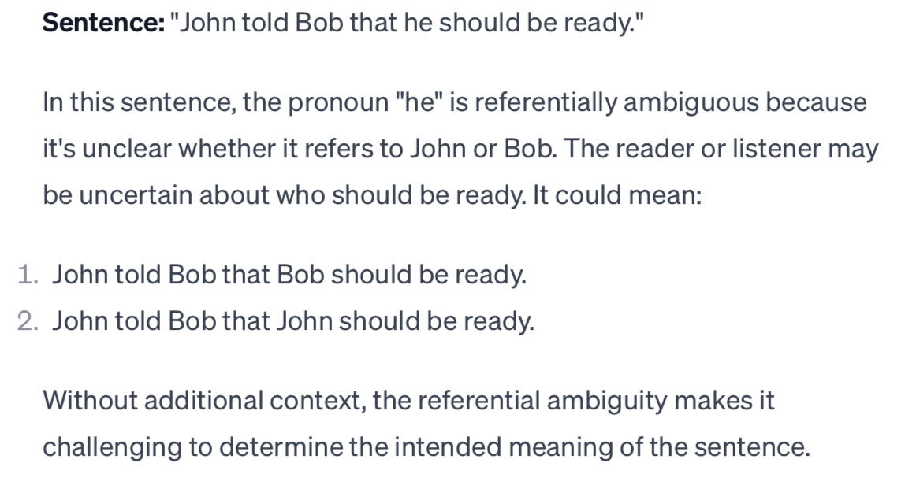
Referential Ambiguity
Referential ambiguity occurs when it is unclear to whom or what a pronoun or a reference in a sentence is pointing.

Slide 21
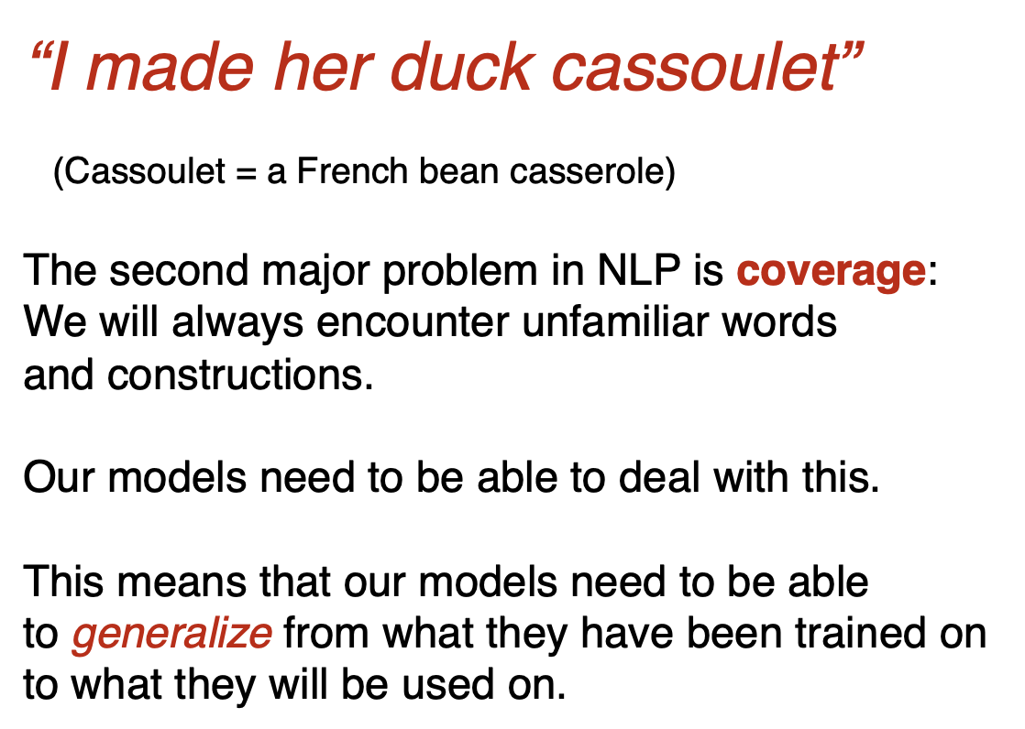
Coverage:

Slide 22
Task: Part-of-speech Tagging
Assigning a specific part of speech (such as noun, verb, adjective, adverb, etc.) to each word in a given text.
POS tagging is an essential step in many NLP applications, including machine translation, information retrieval, and text-to-speech synthesis.
For example, consider the sentence: "The cat is sitting on the mat.”
"The" - Article (DET)
"cat" - Noun (N)
"is" - Verb (V)
"sitting" - Verb (V)
"on" - Preposition (P)
"the" - Article (DET)
"mat" - Noun (N)

Slide 23
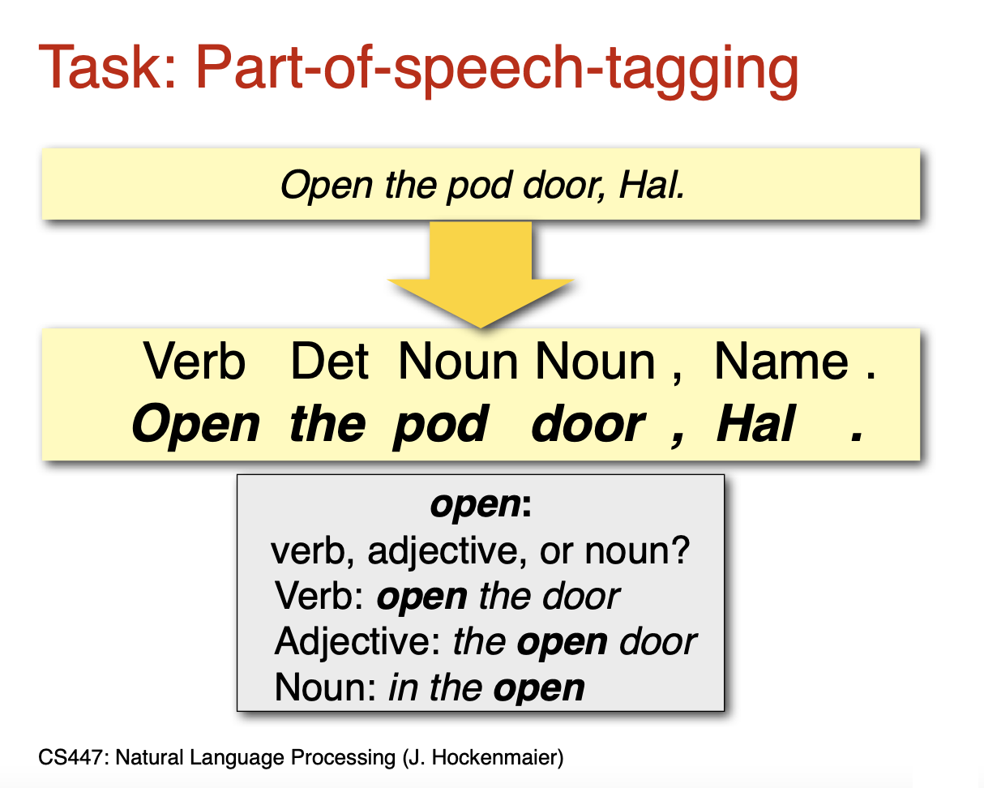
Wait! , not so simple…..

Slide 24
How do we decide?
Define a statistical model
Disambiguation requires statistical models
Ambiguity is a core problem for any NLP task
Statistical models* are one of the main tools to deal with ambiguity.
These models need to be trained (estimated, learned) before they can be used (tested).

